Slide 1
CS 6476 Project 3
Haoran Wang
Haoran.wang@gatech.edu
hwang827
903543952

Slide 2
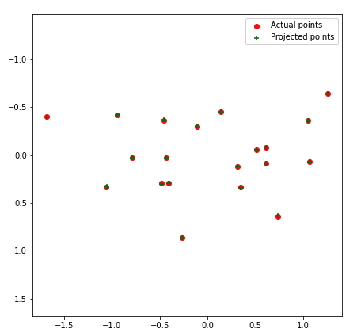
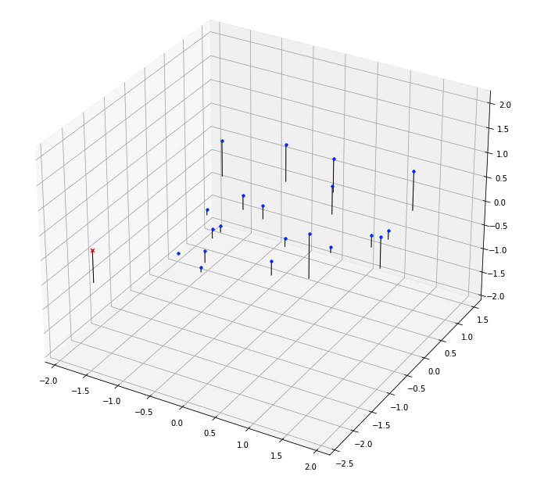
Part 1: Projection matrix
[insert visualization of projected 3D points and actual 2D points for the CCB image we provided here]
[insert visualization of camera center for the CCB image here]

Slide 3
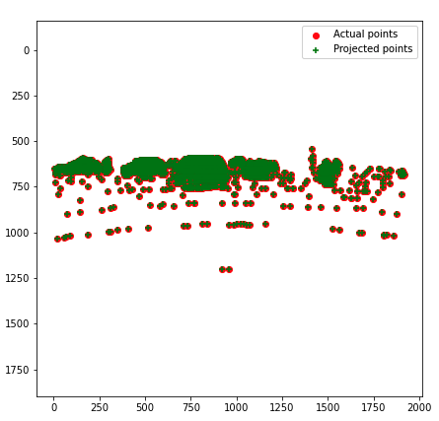
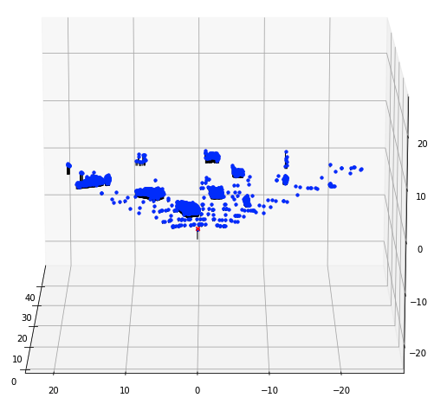
Part 1: Projection matrix
[insert visualization of projected 3D points and actual 2D points for the Argoverse image we provided here]
[insert visualization of camera center for the Argoverse image here]

Slide 4
Part 1: Projection matrix
[What two quantities does the camera matrix relate?]
x=PX. It relates homogeneous 3D points to 2D image points.
[What quantities can the camera matrix be decomposed into?]
Intrinsic and extrinsic parameters.
[List any 3 factors that affect the camera projection matrix.]
Camera orientation, camera projection center and 3D rotation.

Slide 5
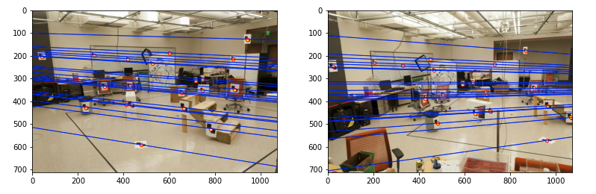
Part 2: Fundamental matrix
[insert visualization of epipolar lines on the CCB image pair]

Slide 6
Part 2: Fundamental matrix
[Why is it that points in one image are projected by the fundamental matrix onto epipolar lines in the other image?]
Any point x’ in the second image matching the point x in the first image must lie on the epipolar line l’. The epipolar line is the projection in the second image of the ray from the point x through the camera center C of the first camera. Thus, there is a map from a point in one image to its corresponding epipolar line in the other image.
[What happens to the epipoles and epipolar lines when you take two images where the camera centers are within the images? Why?]
When the camera centers O and O’ are within the image plane, O’ and O will be the eipiploes, the epipolar lines will conincide at the the epipoles in the image, which is the camera centers. Because the baseline will be connecting O and O’, the potential matches for a point x in one image will be the line l’ in the other image that goes through the camera center O’.

Slide 7
Part 2: Fundamental matrix
[What does it mean when your epipolar lines are all horizontal across the two images?]
Image planes of camera are parallel to each other and to the baseline, camera center are at the same height, and focal length are the same.
[Why is the fundamental matrix defined up to a scale?]
The fundamental matrix is defined by the equation x'^t F * x = 0. Hence, once we have a solution to the function, we can always multiply it by a scalar, that also forms a solution. Therefore, the fundamental matrix is defined up to a scale.
[Why is the fundamental matrix rank 2?]
Because it represents a mapping from the 2-dimensional projective plane of the first image to the pencil of epipolar lines through the epipole e. Thus, it represents a mapping from a 2-dimensional onto a 1-dimensional projective space, and hence must have rank 2.

Slide 8
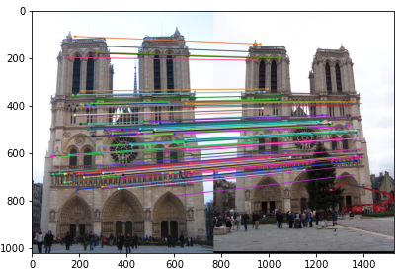
Part 3: RANSAC
[insert visualization of correspondences on Notre Dame after RANSAC]

Slide 9
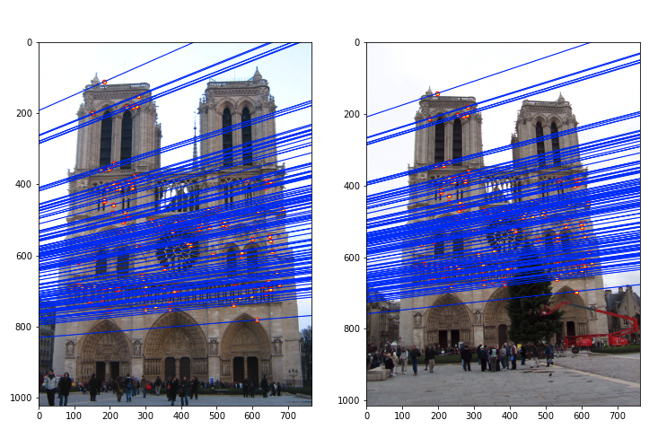
Part 3: RANSAC
[insert visualization of epipolar lines on the Notre Dame image pair]

Slide 10
Part 3: RANSAC
[How many RANSAC iterations would we need to find the fundamental matrix with 99.9% certainty from your Mt. Rushmore and Notre Dame SIFT results assuming that they had a 90% point correspondence accuracy?]
15 iterations (with sample_size = 9) or 13 iterations (with sample_size = 8)
[One might imagine that if we had more than 9 point correspondences, it would be better to use more of them to solve for the fundamental matrix. Investigate this by finding the # of RANSAC iterations you would need to run with 18 points.]
43 iteration needed to achieve 99.9% certainty with 90% point correspondence accuracy using 18 points.
[If our dataset had a lower point correspondence accuracy, say 70%, what is the minimum # of iterations needed to find the fundamental matrix with 99.9% certainty?]
168 iterations needed to find the fundamental matrix with 99.9% certainty with point correspondence accuracy 70%.

Slide 11
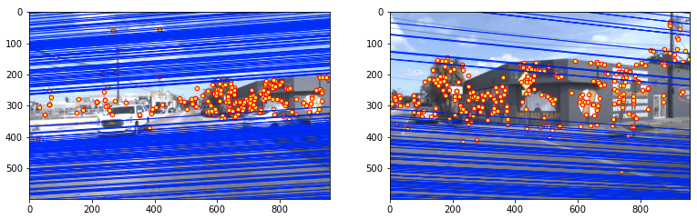
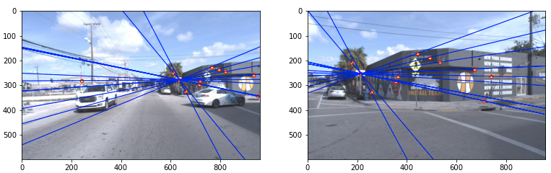
Part 4: Performance comparison
[insert visualization of epipolar lines on the Argoverse image pair using the linear method]
[insert visualization of epipolar lines on the Argoverse image pair using RANSAC]

Slide 12
Part 4: Performance comparison
[Describe the different performance of the two methods.]
With the implementation from part 2, the epipolar are almost parallel and most of the epipolar doesn’t go through points. Whereas using RANSAC, the epipolars are able to intercept at a point in the image and all the epipolar goes through its corresponding points.
[Why do these differences appear?]
Because there are outliers when using all the points to computing the fundamental matrix with the implementations from part 2. Therefore, the fundamental matrix can’t be accurately computed.
[Which one should be more robust in real applications? Why?]
RANSAC is more robust in real application. Because it uses random sampling to estimate the fundamental matrix and use the estimated fundamental matrix to find the inlier points. And it uses multiple iteration to find the best fundamental matrix with the greatest number of inliers.

Slide 13
Part 5: Visual odometry
[How can we use our code from part 2 and part 3 to determine the “ego-motion” of a camera attached to a robot (i.e., motion of the robot)?]
To get the “ego-motion”, we just need to get the rotation from one image to the next, this can be done by getting the fundamental matrix of these two images using RANSAC with code from part 2 and part 3 and then get the essential matrix of them to recover the camera rotation and translation. Then, the ego-motion can be determined by getting the rotation from previous world frame matrix.
[In addition to the fundamental matrix, what additional camera information is required to recover the ego-motion?]
The essential matrix, and the recovered relative rotation and translation.

Slide 14
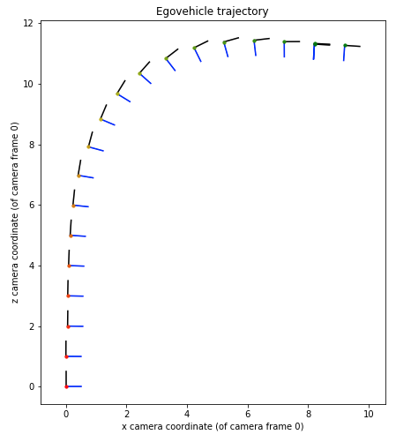
Part 5: Visual odometry
[Attach a plot of the camera’s trajectory through time]

